Slide 1
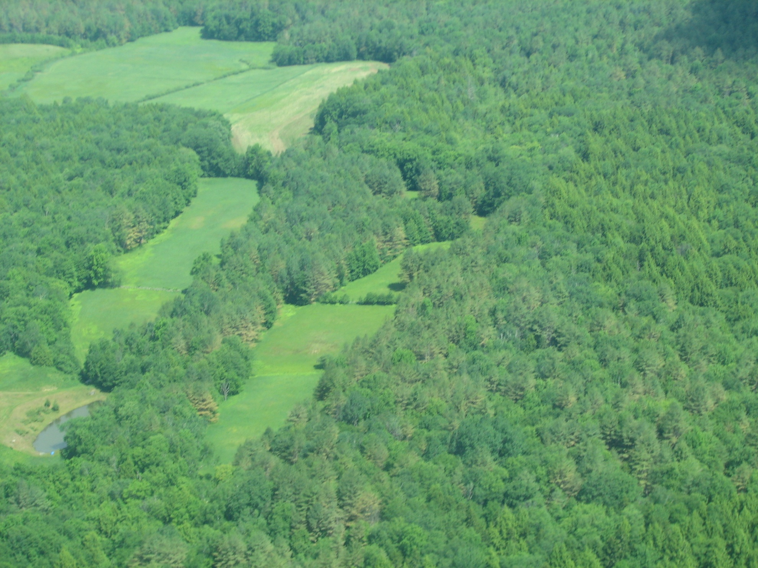
Learning about Fungus on White Pine
Forest Watch November 2012
Forest Watch thanks Dr. Isabel Munck, US Dept. of Agriculture Forest Service, Northeastern Area, State and Private Forestry, for sharing her research regarding fungal predation on the white pines. This photo, taken by the Vermont Division of Forestry, shows stressed white pine foliage, where tree tops appear brown.

Slide 2
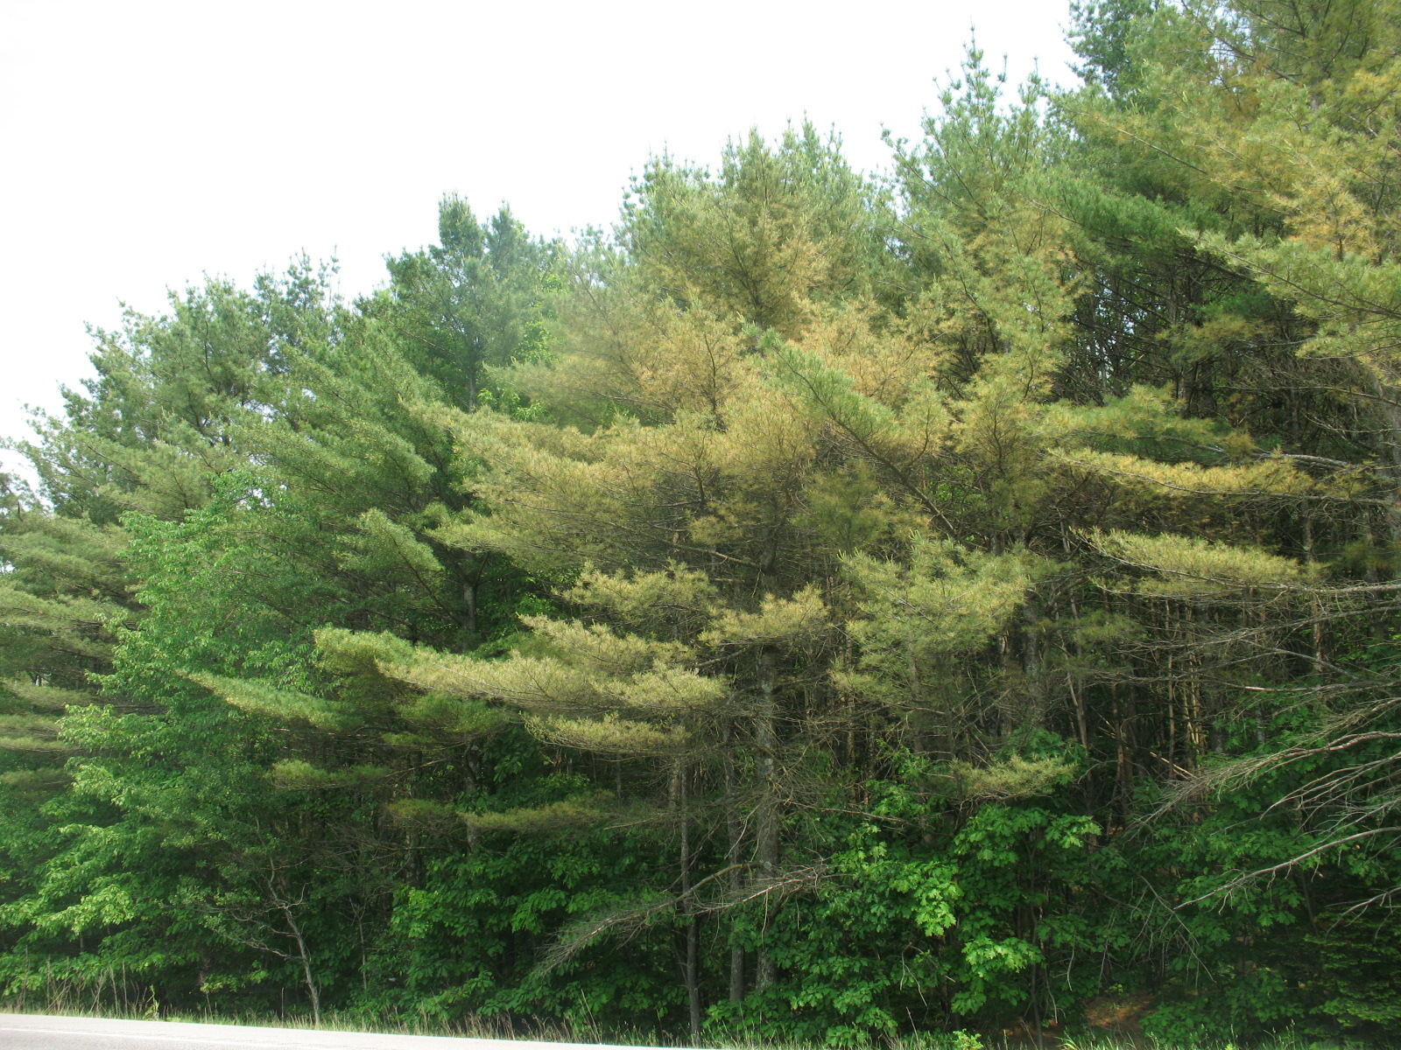
6/30/2011

Slide 3
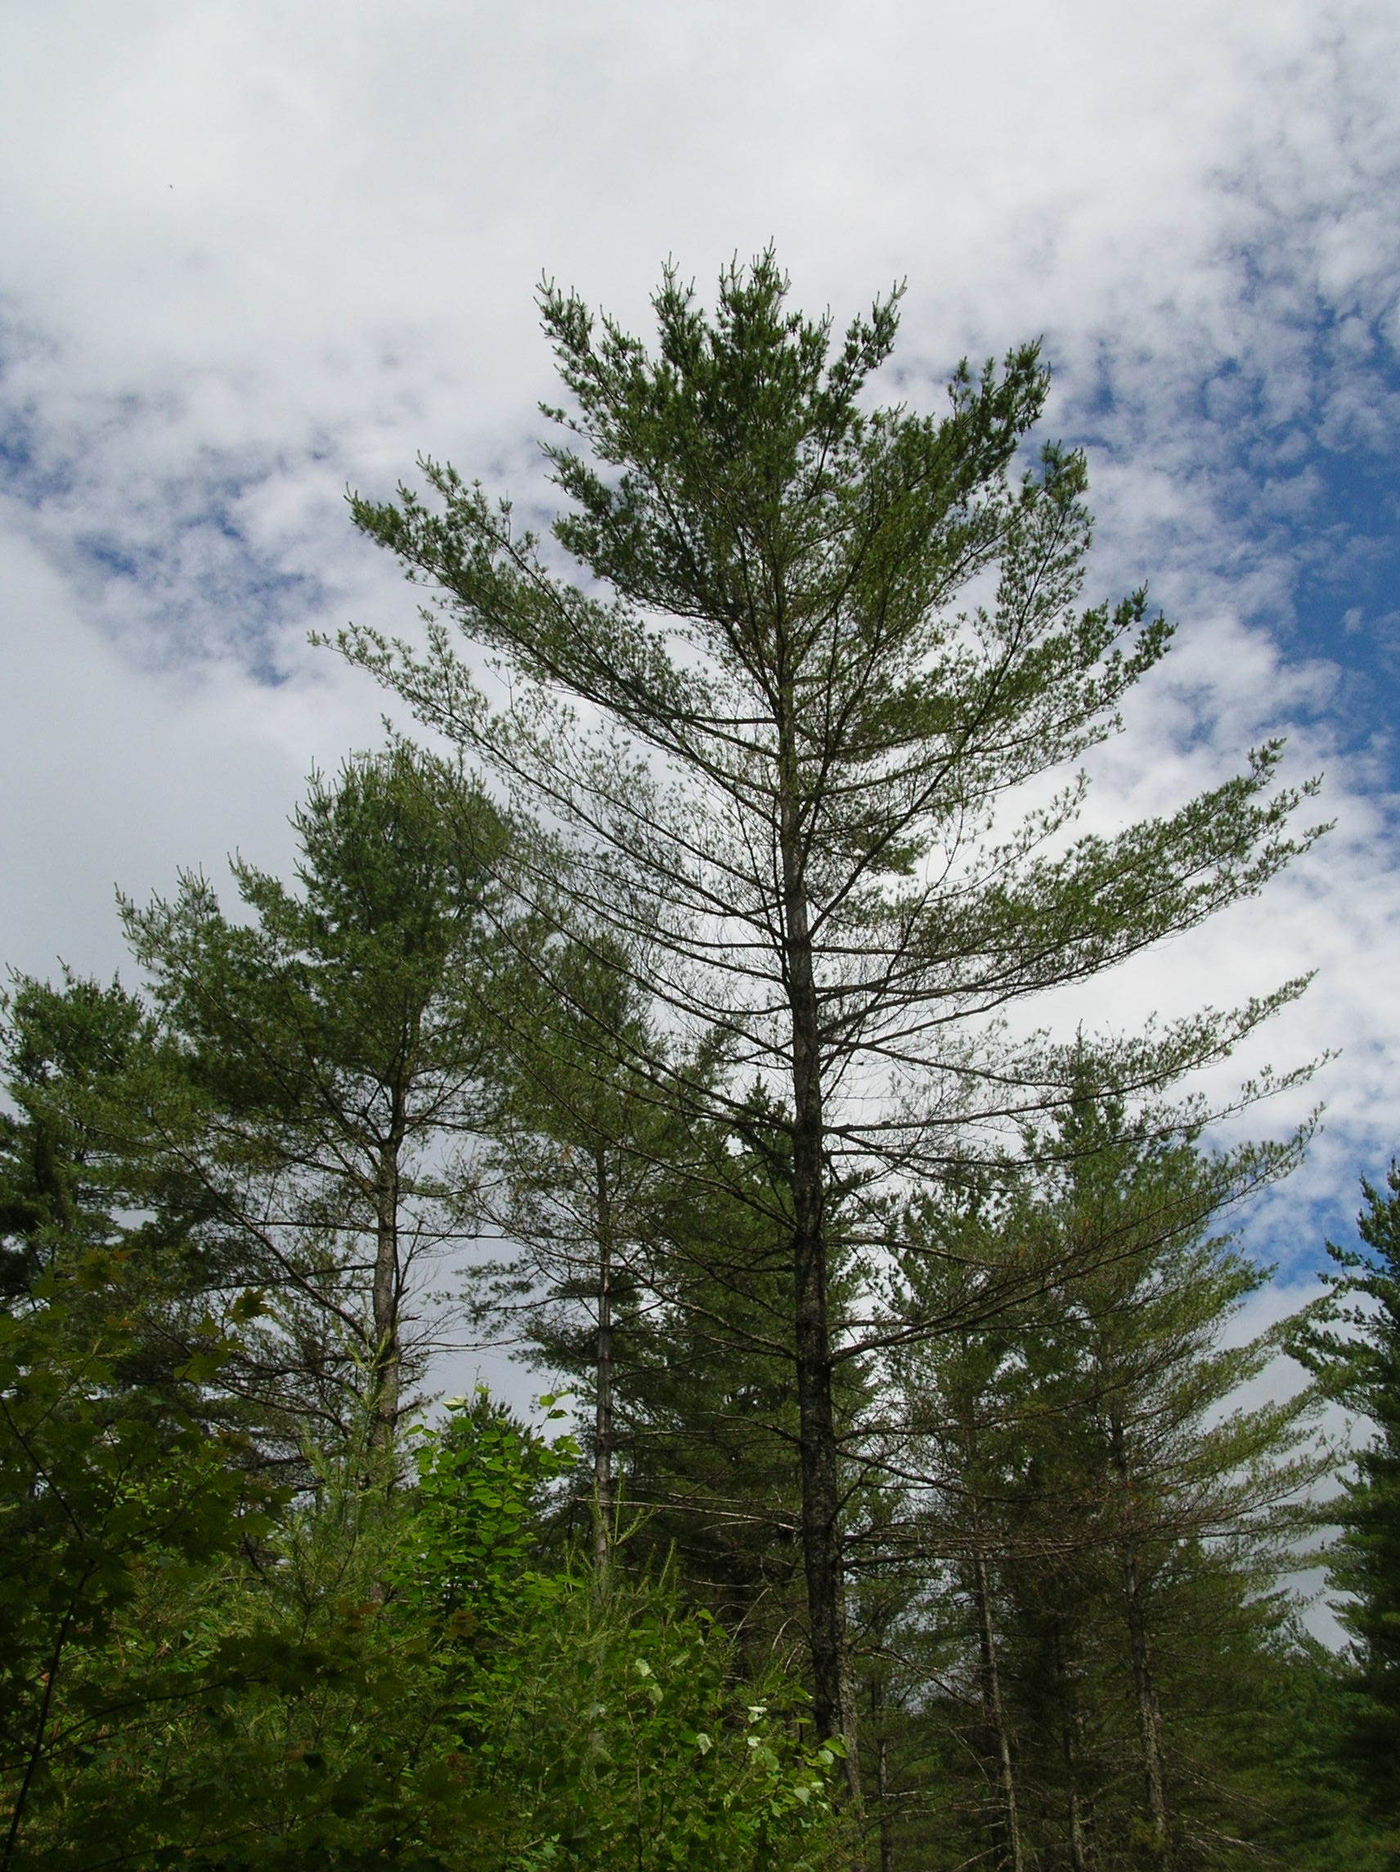
6/30/2011

Slide 4
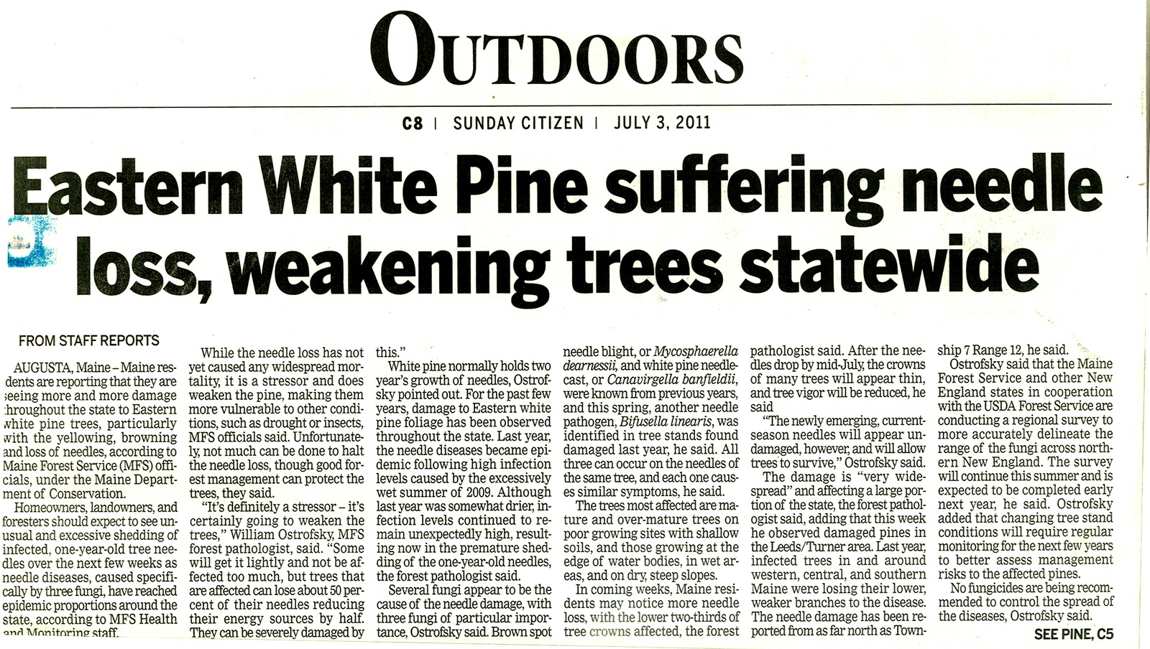

Slide 5
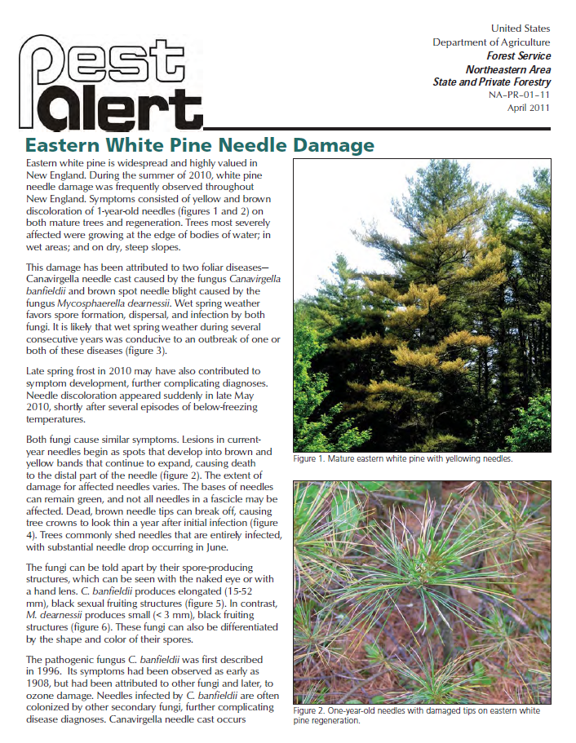

Slide 6
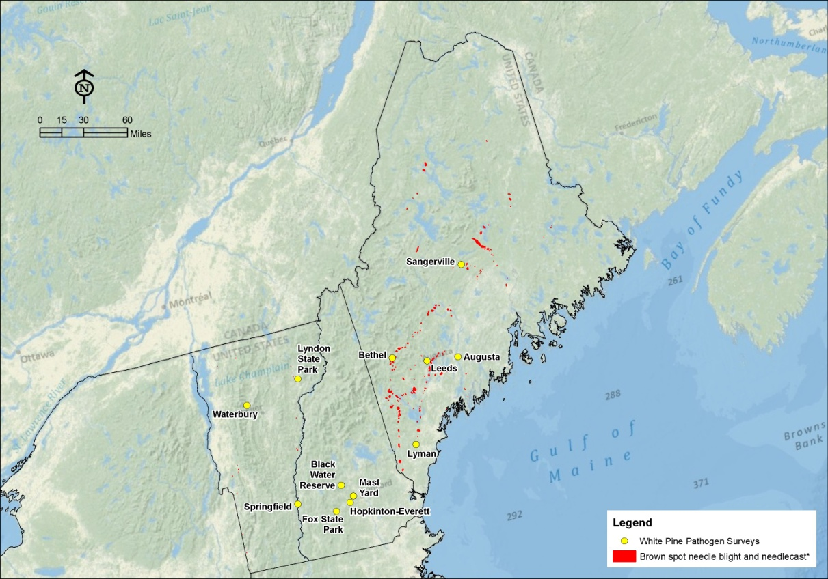

Slide 7
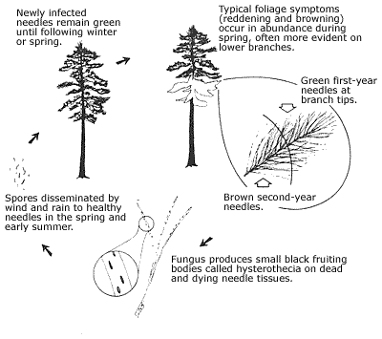
Needle casts
http://www.floridaforestservice.com/publications/Insects_and_Diseases/td_cf_needle_cast_fig10.html

Slide 8
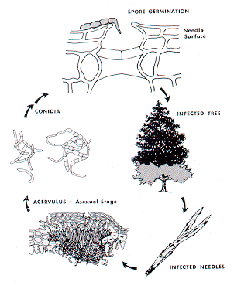
Brown spot needle blight- Mycosphaerella dearnesii
http://www.na.fs.fed.us/spfo/pubs/fidls/br_spot_pines/brown-spot.htm

Slide 9
Methods
Samples collected in 4/2011 and 6/2011 from 13 sites in VT, NH, & ME damaged in 2010
3-5 trees sampled per site (1 L zip-lock bag per tree)
All branch tips were examined
Needles from a representative branch/tree incubated for 24-48 hr at 25 ̊C
Fruiting bodies examined & photographed

Slide 10
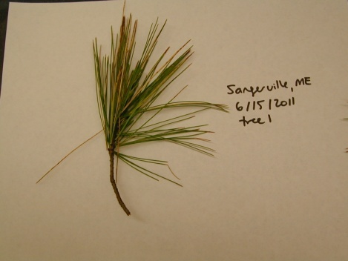
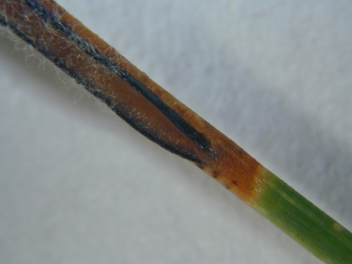
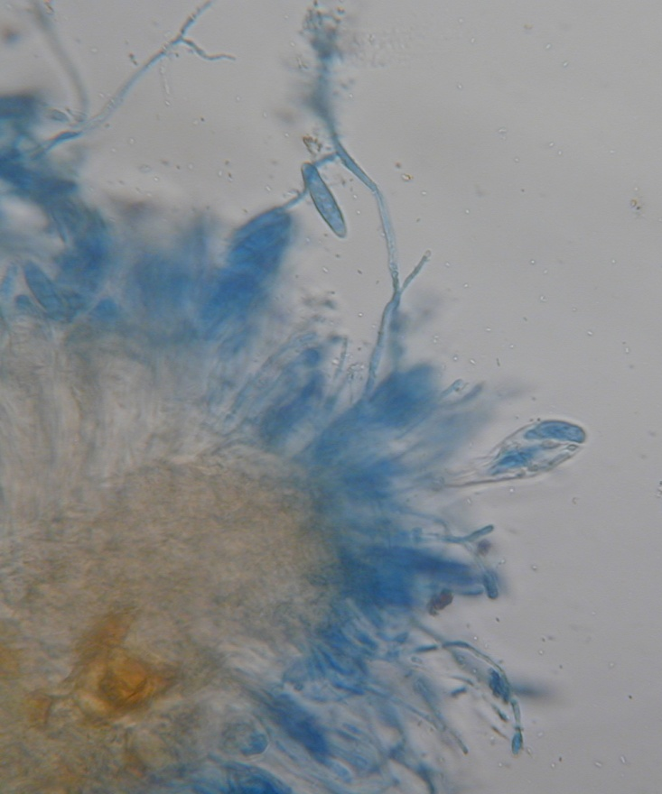
Munck Study
Canavirgella needle cast caused by
Canavirgella bandfieldii

Slide 11
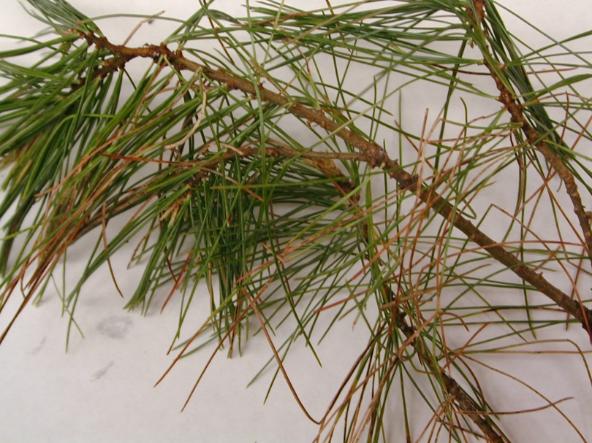
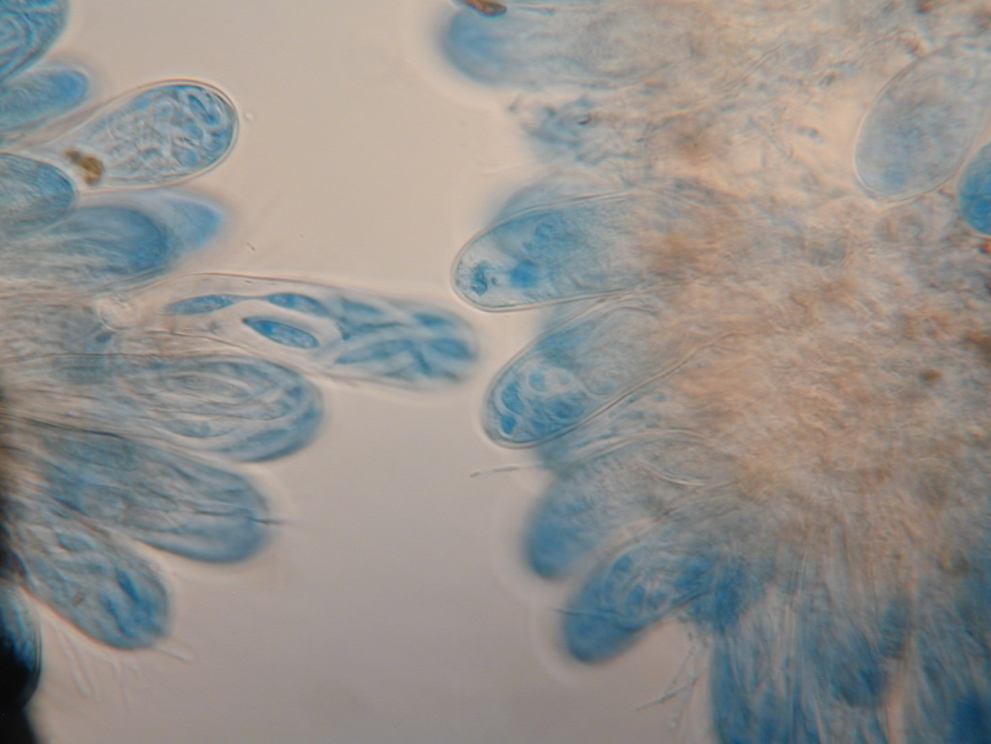
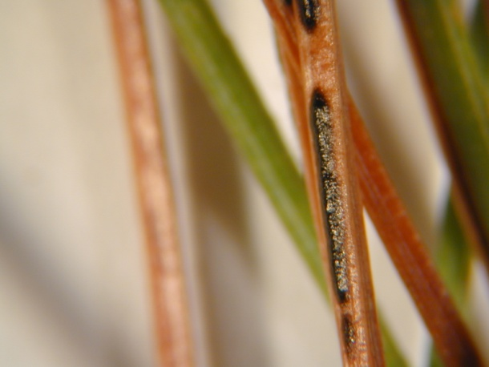
Munck Study
Bifusella needle cast caused by
Bifusella linearis

Slide 12
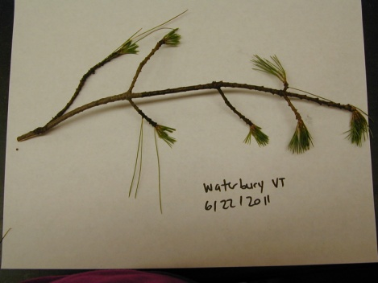
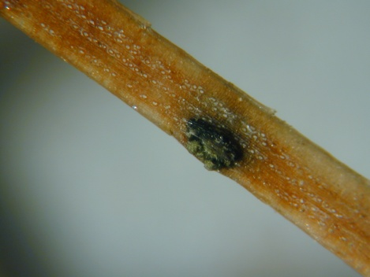
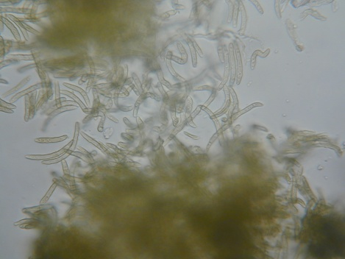
Brown spot needle blight caused by
Mycosphaerella dearnessii

Slide 13
Conclusions from 2011
At least 3 pathogenic fungi present at the same site and more than one pathogen on the same tree
Mycosphaerella dearnessii was the most frequently observed & widely distributed pathogen
Mycosphaerella dearnessii most constantly associated with chlorosis and defoliation

Slide 14
White Pine Needle Damage 2012
Damage in 2012 more severe than 2011 in VT, NH, and MA
Damage in 2012 less severe than 2011 in ME
WPND is also a problem in Canada and Europe

Slide 15
WPND follow up
Kirk Broder’s Lab at UNH (cultures & DNA) confirmed M. dearnessii is most frequent pathogen associated with needle damage
Several other fungi (potential pathogens) were also isolated from symptomatic needles
Seedlings will be inoculated with these isolates
Predictive climate model will be developed
Tagged trees will be monitored/cored

Slide 16
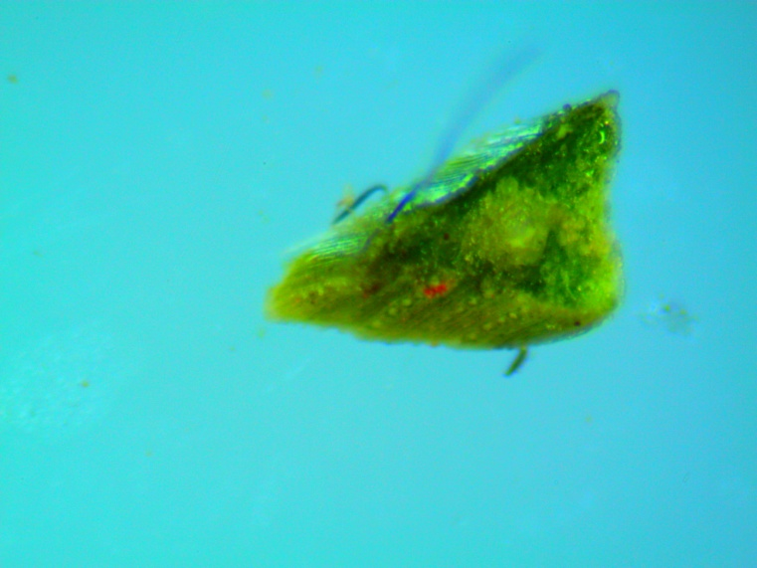
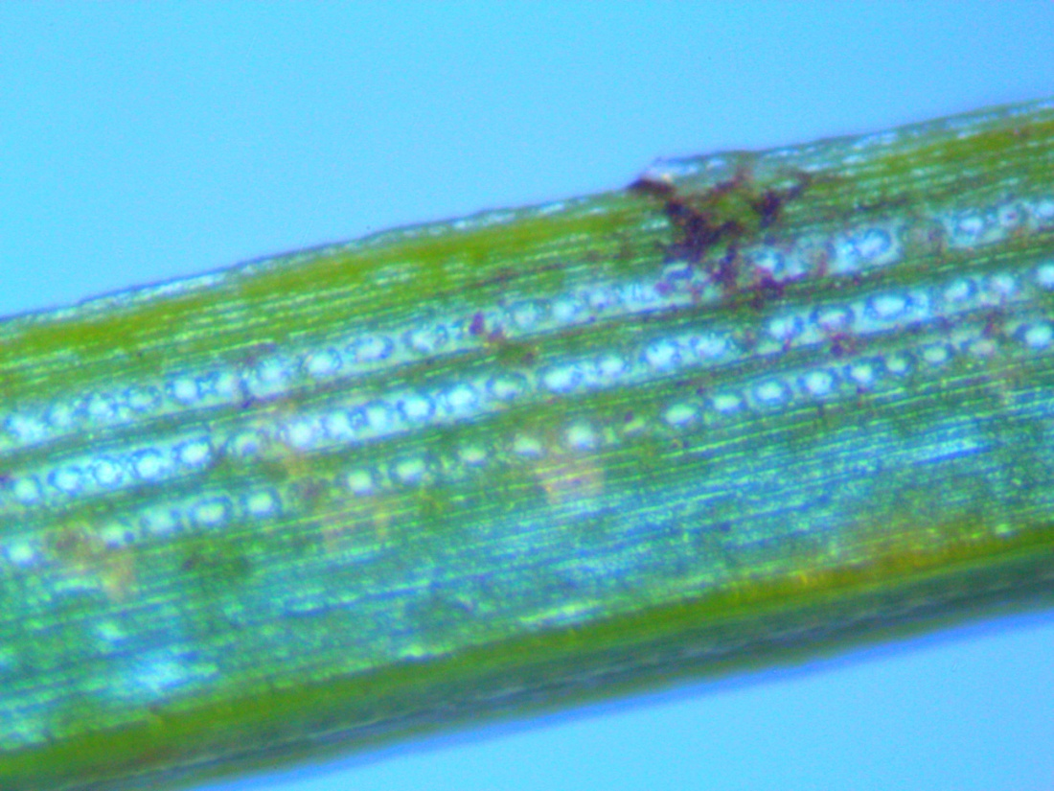
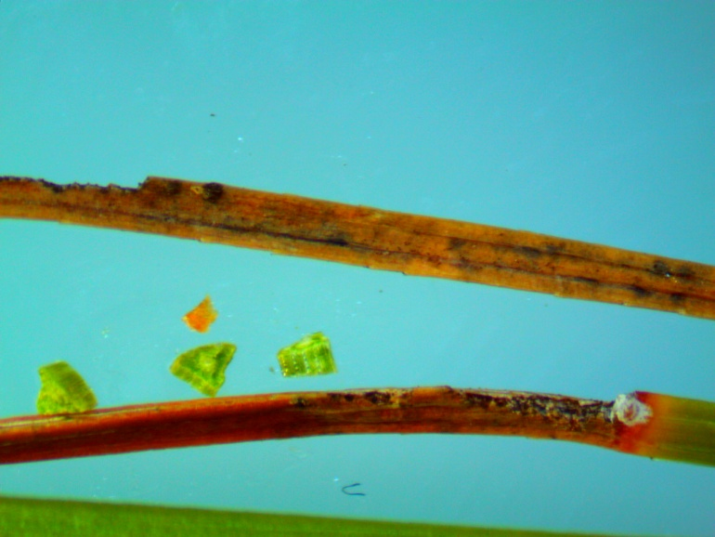
Dublin School, Dublin NH
2nd Year Needles

Slide 18
REIP Study
Dublin’s two worst trees have REIPs of 719.3 and 714.6 in first year needles, very unusual. No tree is higher than 725.4. The average this year, 728.

Slide 19
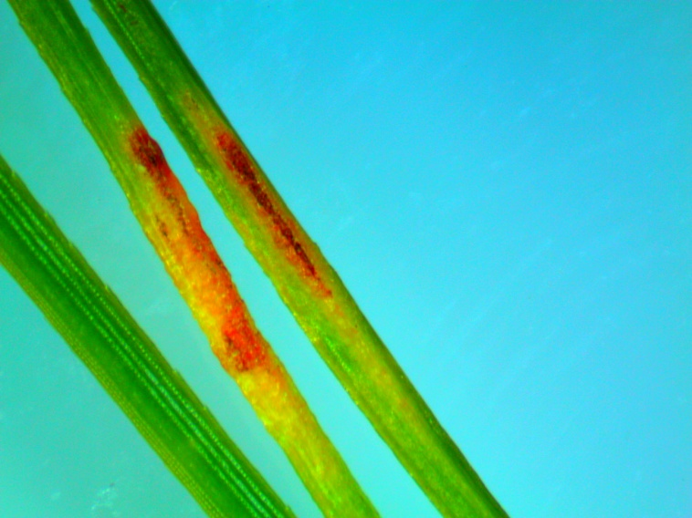
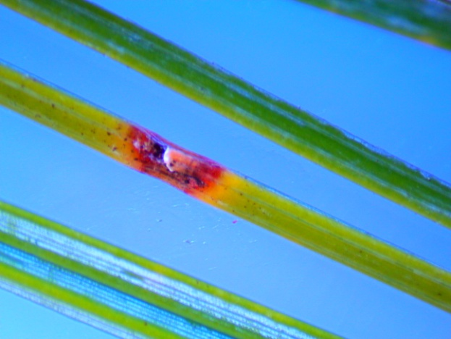
Dublin School, Dublin NH
1st Year Needles

Slide 20
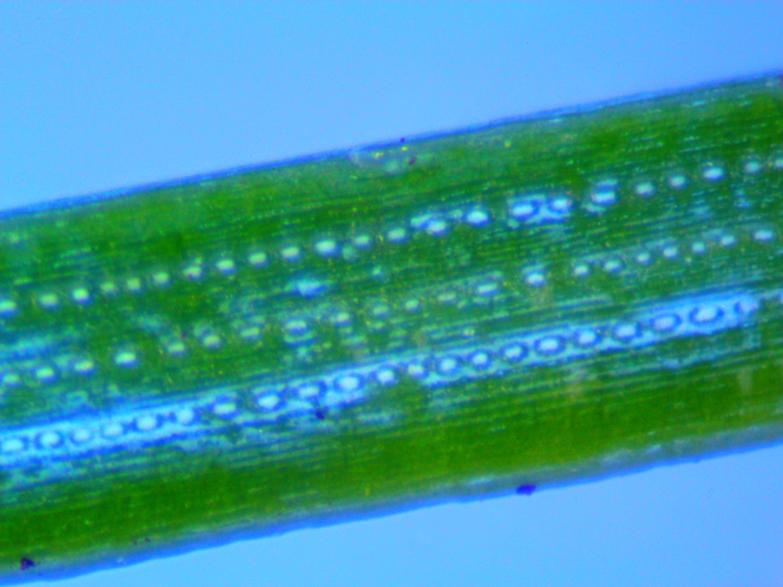
Healthy Needle- Dublin’s 1942

Slide 21
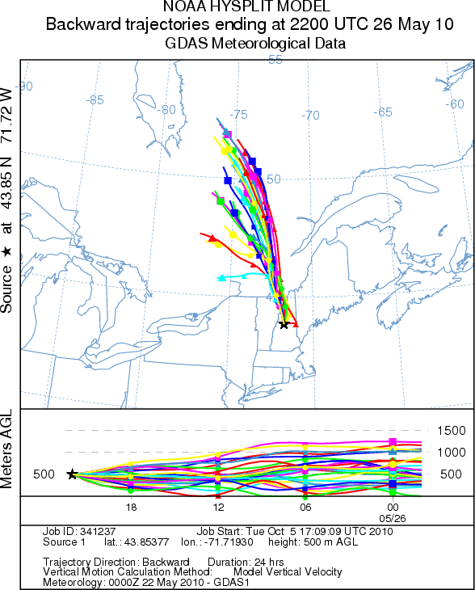

Slide 22
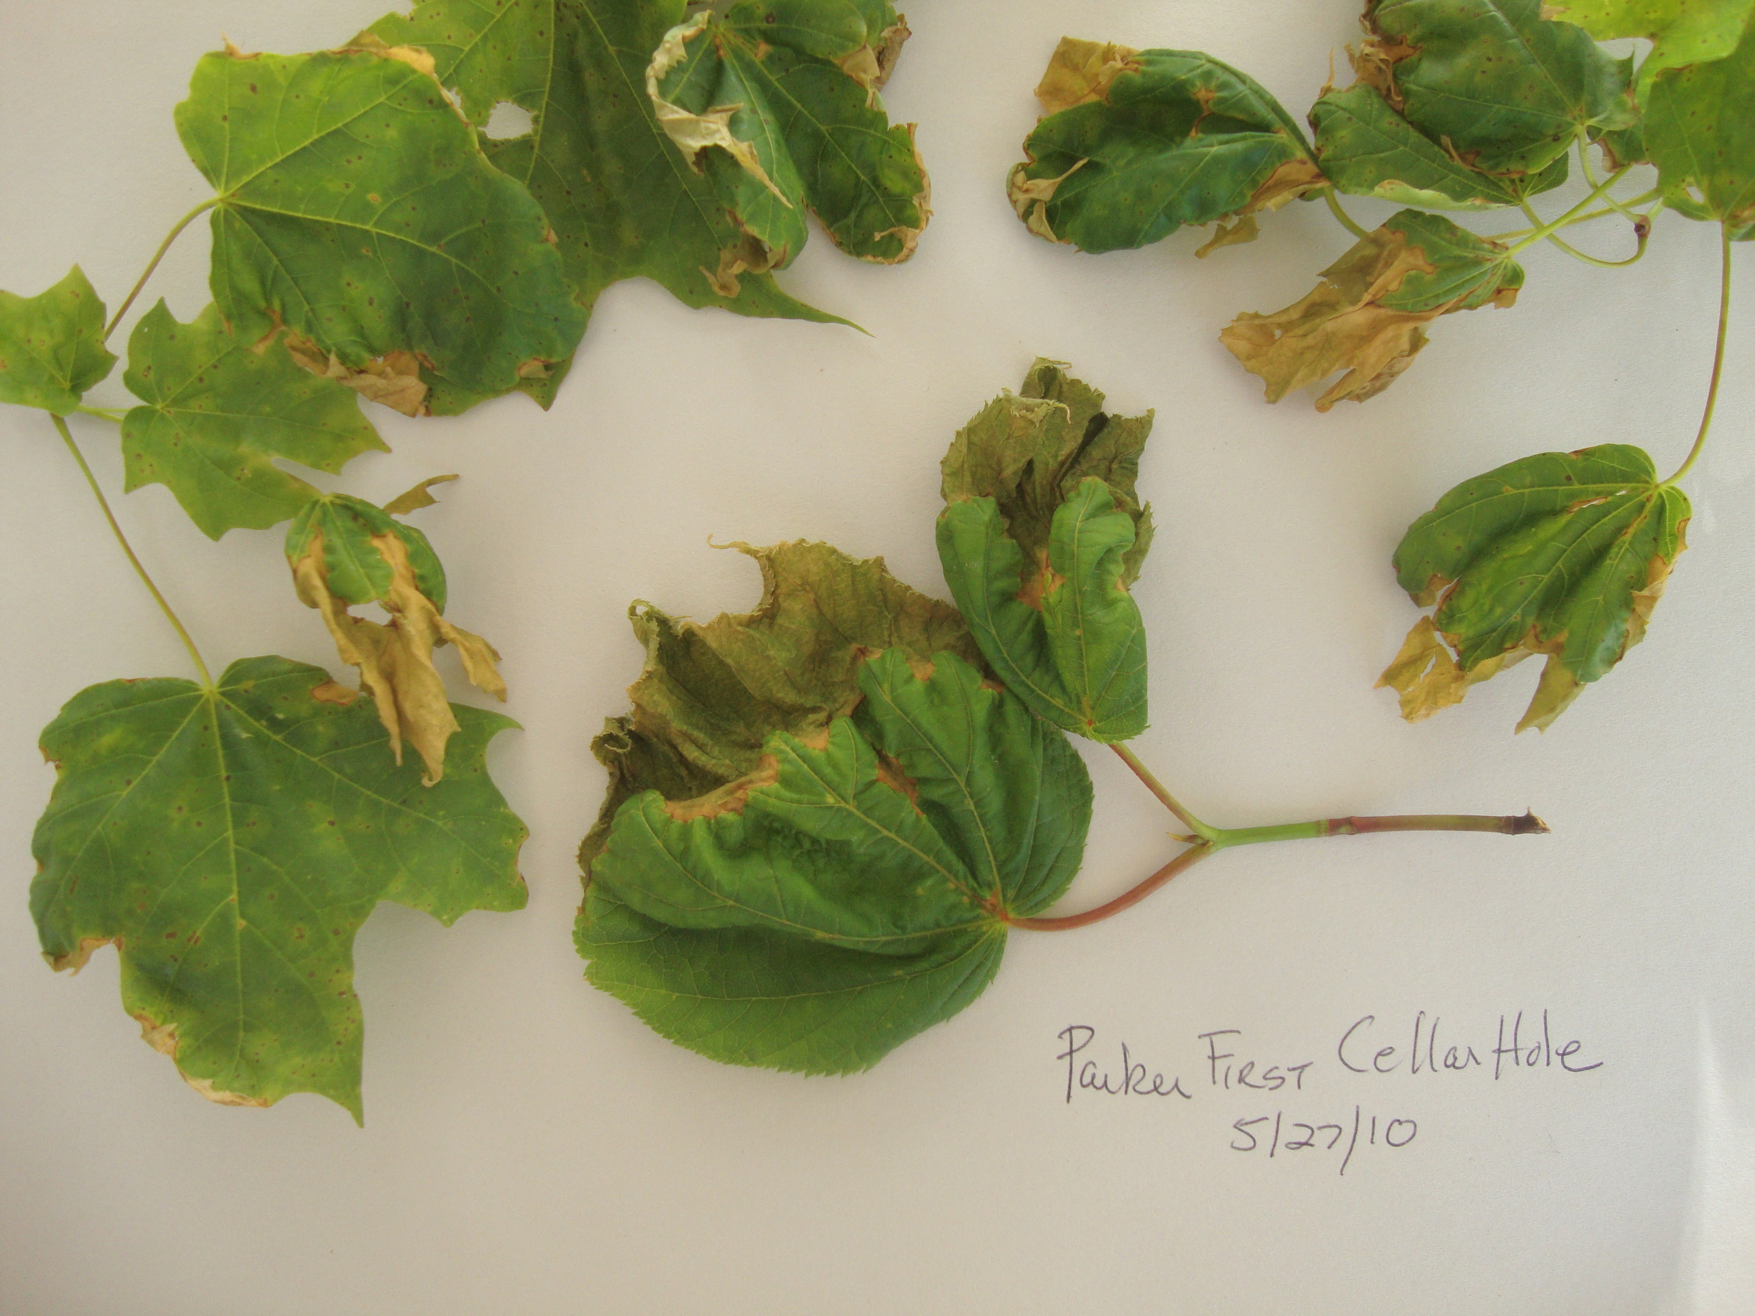
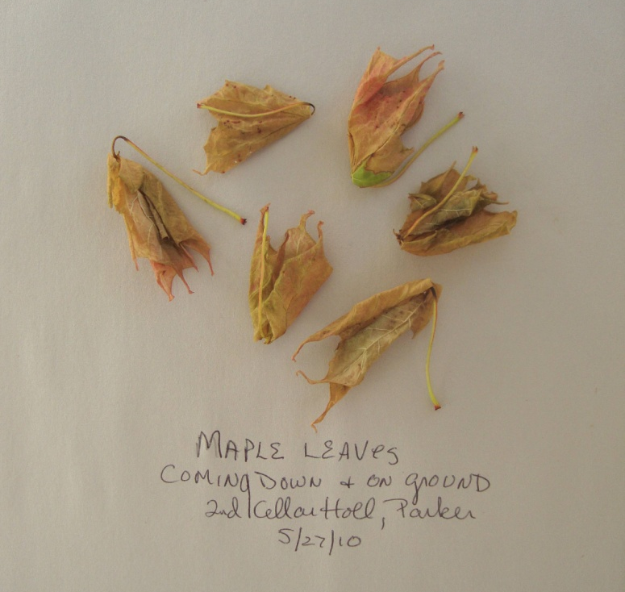
PAN Damage

